Slide 1
Congestion Control Algorithms
Approaches to congestion control
Traffic-aware routing
Admission control
Traffic throttling
Load shedding
1

Slide 2
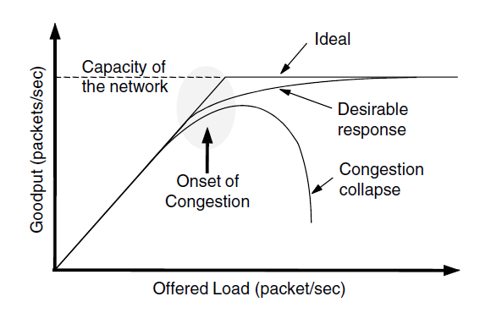
Congestion Control Algorithms
When too much traffic is offered, congestion sets in and performance degrades sharply.

Slide 3
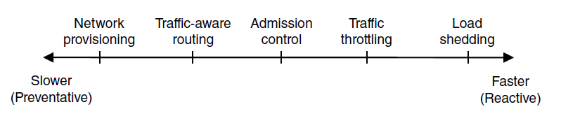
Approaches to Congestion Control
Timescales of approaches to congestion control

Slide 4
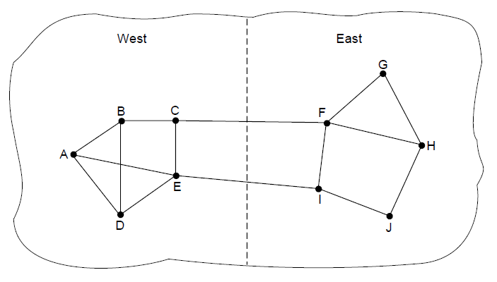
Traffic-Aware Routing
A network in which the East and West parts
are connected by two links.

Slide 5
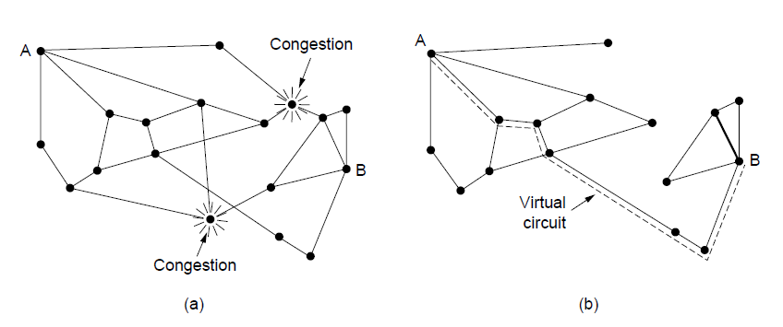
Admission Control
(a) A congested network. (b) The portion of the network that is not congested. A virtual circuit from A to B is also shown.

Slide 6
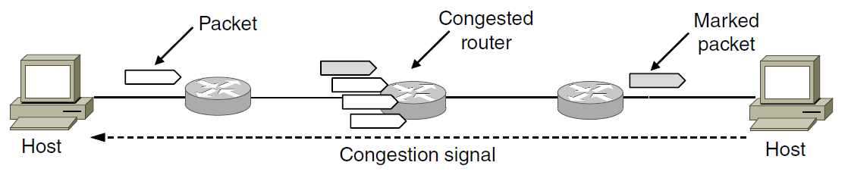
Traffic Throttling
Explicit congestion notification

Slide 7
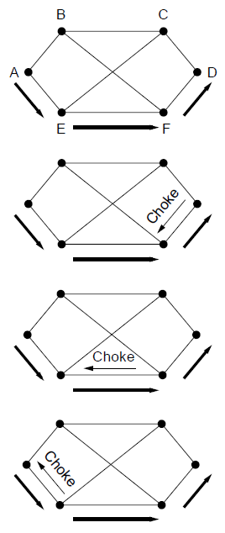
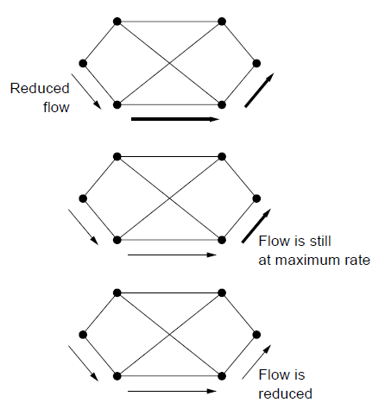
Load Shedding
(a)
(b)
(a) A choke packet that affects only the source..

Slide 8
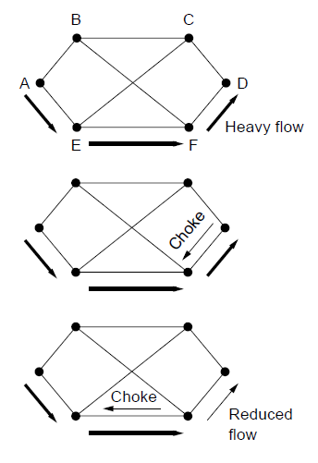
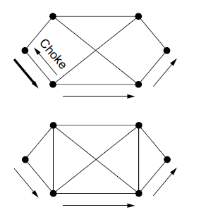
Load Shedding
(a)
(b)
(b) A choke packet that affects each hop it passes through.

Slide 9
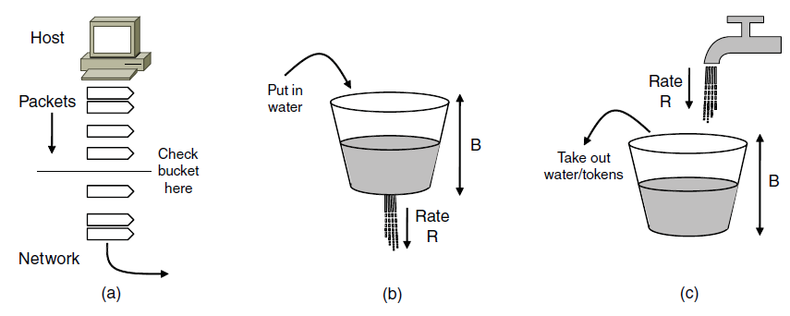
Traffic Shaping (1)
(a) Shaping packets. (b) A leaky bucket. (c) A token bucket

Slide 10
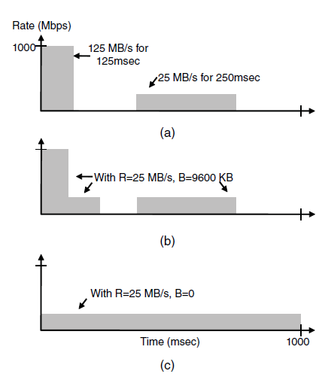
Traffic Shaping (2)
(a) Traffic from a host. Output shaped by a token bucket of rate 200 Mbps and capacity (b) 9600 KB, (c) 0 KB.

Slide 11
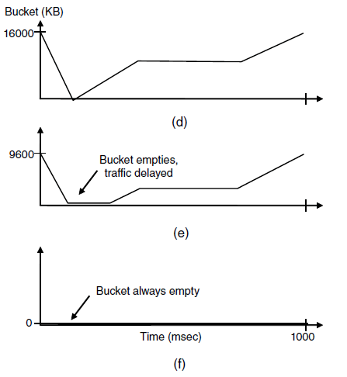
Traffic Shaping (3)
Token bucket level for shaping with rate 200 Mbps and capacity (d) 16000 KB, (e) 9600 KB, and (f) 0KB..

Slide 12
Internetworking
How networks differ
How networks can be connected
Tunneling
Internetwork routing
Packet fragmentation

Slide 13
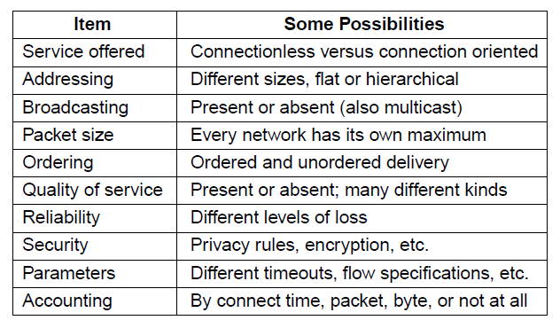
How Networks Differ
Some of the many ways networks can differ

Slide 14
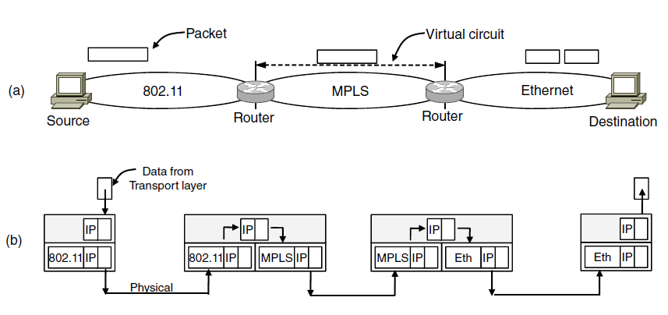
How Networks Can Be Connected
A packet crossing different networks.
Network and link layer protocol processing.

Slide 15
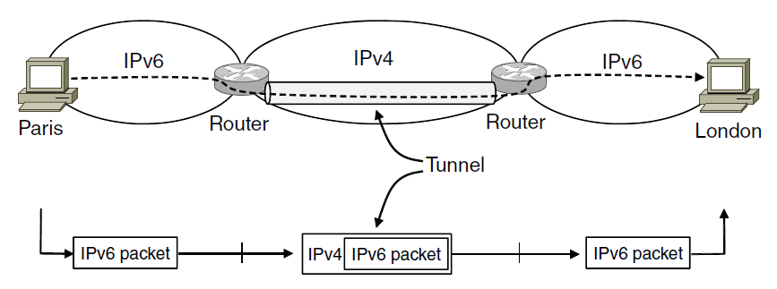
Tunneling (1)
Tunneling a packet from Paris to London.

Slide 16
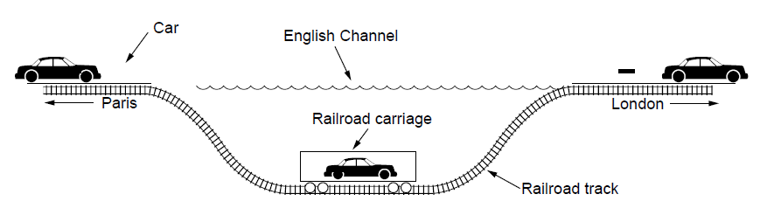
Tunneling (2)
Tunneling a car from France to England

Slide 17
Packet Fragmentation
Packet size issues:
Hardware (e.g., size of an Ethernet Frame)
Operating system(e.g., all buffers 512 bytes)
Protocols (e.g., the no of bits in the packet
length field)
Compliance with (inter)national standard.
Reduce error-induced retransmissions
Prevent packet occupying channel too long

Slide 18
IP Version 6 Goals
Support billions of hosts
Reduce routing table size
Simplify protocol
Better security
Attention to type of service
Aid multicasting
Roaming host without changing address
Allow future protocol evolution
Permit coexistence of old, new protocols. . .

Slide 19
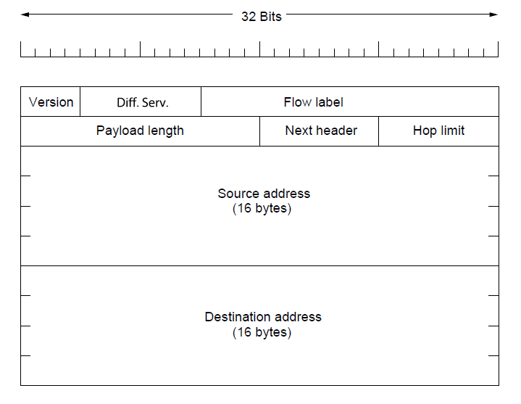
IP Version 6
The IPv6 fixed header (required).

Slide 20
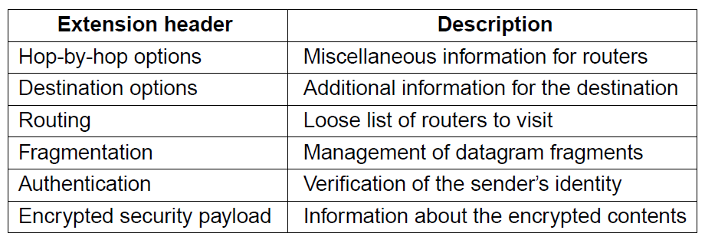
IP Version 6
IPv6 extension headers

Slide 21
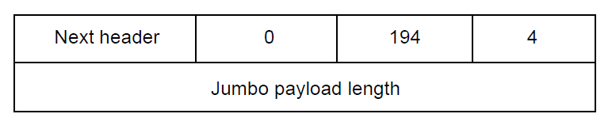
IP Version 6
The hop-by-hop extension header for
large datagrams (jumbograms).

Slide 22
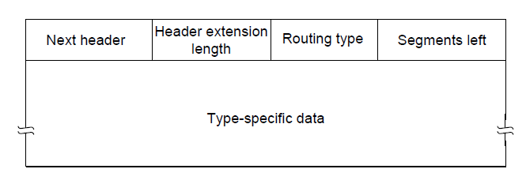
IP Version 6
The extension header for routing.

